Slide 1


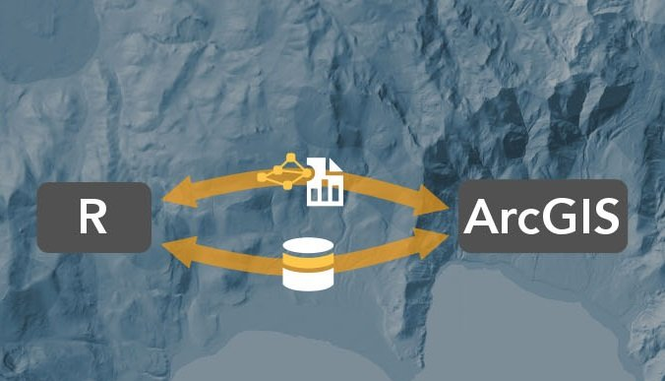
Intro to R-ArcGIS Bridge: the arcgisbinding Package
Yixuan(E Hsuan) Zhao
SUNY-Buffalo-GEO511-SDS
Course instructor : Professor. Adam M. Wilson

Slide 2



INTRODUCTION
Load ArcGIS data into their R workspaces for answering statistical questions.
Create tools and toolboxes to integrate ArcGIS and R capabilities. Running R scripts as tools is like running other geoprocessing tools.
Have access to all of the capabilities of R by simply referencing R scripts as the source file in a geoprocessing script.
Bridges the gap between traditional ArcGIS users and statistically based R developers.
Access R code through geoprocessing scripts and run the scripts in ArcGIS Desktop.
Access to an organization's GIS data through the R-ArcGIS bridge, and they also have access to the spatial analysis tools and mapping power of ArcGIS.
Notes:
The R-ArcGIS bridge bridges the gap between traditional ArcGIS users and statistically based R developers. ArcGIS users can now create custom tools and toolboxes that use both the spatial and statistical capabilities found in ArcGIS and R.R-ArcGIS 桥梁弥合了传统 ArcGIS 用户和基于统计的 R 开发人员之间的差距。 ArcGIS 用户现在可以创建使用 ArcGIS 和 R 中的空间和统计功能的自定义工具和工具箱。
As an ArcGIS user, you can now access R code through geoprocessing scripts and run the scripts in ArcGIS Desktop. R users greatly benefit in their work by having direct access to an organization's GIS data through the R-ArcGIS bridge, and they also have access to the spatial analysis tools and mapping power of ArcGIS.作为 ArcGIS 用户，您现在可以通过地理处理脚本访问 R 代码并在 ArcGIS Desktop 中运行脚本。 R 用户可以通过 R-ArcGIS 桥直接访问组织的 GIS 数据，从而极大地受益于他们的工作，并且他们还可以访问 ArcGIS 的空间分析工具和绘图功能。
R users can use the R-ArcGIS bridge to load ArcGIS data into their R workspaces for answering statistical questions. Accessible data is not just limited to feature class type data but also includes layers and tables.R 用户可以使用 R-ArcGIS 桥将 ArcGIS 数据加载到他们的 R 工作空间中以回答统计问题。 可访问数据不仅限于要素类类型数据，还包括图层和表格。
ArcGIS developers can create tools and toolboxes to integrate ArcGIS and R capabilities. Running R scripts as tools is like running other geoprocessing tools. The tool dialog and parameter options are available for configuring the tool for execution.ArcGIS 开发人员可以创建工具和工具箱来集成 ArcGIS 和 R 功能。 将 R 脚本作为工具运行就像运行其他地理处理工具一样。 工具对话框和参数选项可用于配置工具以执行。
ArcGIS Desktop users have access to all of the capabilities of R by simply referencing R scripts as the source file in a geoprocessing script. R also provides access to thousands of freely downloadable packages available for performing specific statistical tasks.ArcGIS Desktop 用户只需将 R 脚本引用为地理处理脚本中的源文件即可访问 R 的所有功能。 R 还提供对数千个可免费下载的软件包的访问，这些软件包可用于执行特定的统计任务。

Slide 3





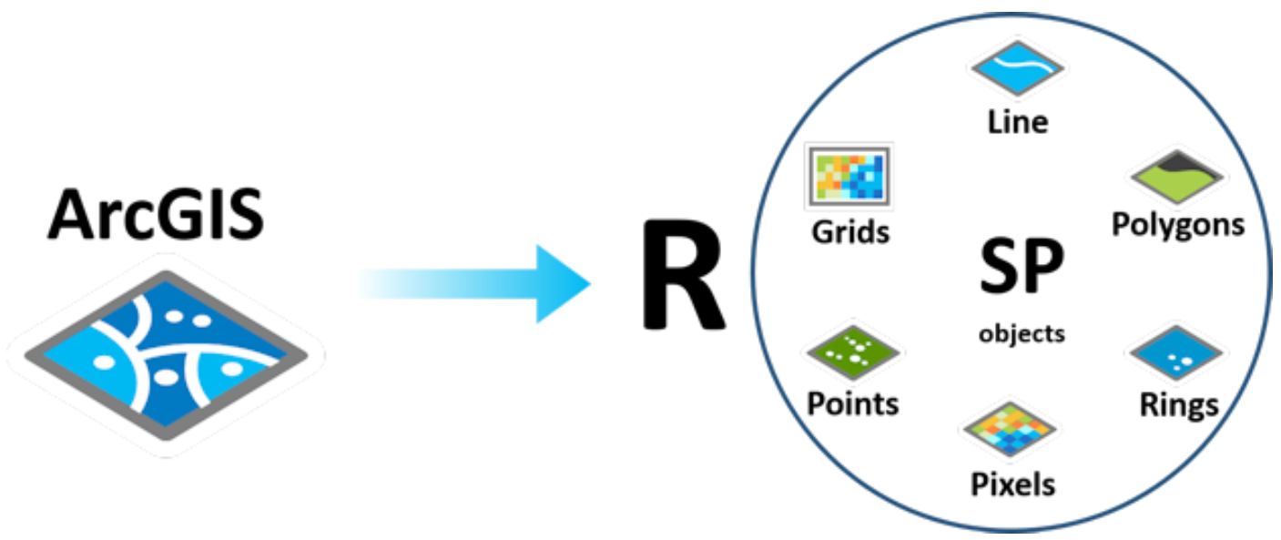



AUTHOR
Space Analysis
Image& Remote Sensing
Visualization
Real-time GIS
3D GIS
Data collection& management
Notes:
ArcGIS is a complete set of GIS platform products produced by Esri with more than 40 years of geographic information system (GIS) consulting and R&D experience. It has powerful capabilities for map making, spatial data management, spatial analysis, spatial information integration, publishing and sharing. ArcGIS Pro is the essential application for creating and manipulating spatial data on the desktop. It provides tools for displaying, analyzing, compiling, and sharing data in 2D and 3D environments.ArcGIS是Esri公司集40余年地理信息系统（GIS）咨询和研发经验制作的一套完整的GIS平台产品，具有强大的地图制作、空间数据管理、空间分析、空间信息整合、发布与共享的能力。ArcGIS Pro 是在桌面上创建和处理空间数据的基本应用程序。它提供用于在 2D 和 3D 环境中显示、分析、编译和共享数据的工具。
The arcgisbinding package is designed to allow you to extend your ArcGIS workflow to include R, and your R analysis to include rich geospatial analysis. With the power of the R-ArcGIS Bridge, you can easily transfer data from ArcGIS to R to access a wide range of statistical packages and functions that you may need for further analysis. When complete, the bridge allows you to transfer data back to ArcGIS to take advantage of ArcGIS's mapping, publishing, and sharing capabilities. arcgisbinding包旨在允许您扩展 ArcGIS 工作流程以包含 R，并扩展您的 R 分析以包含丰富的地理空间分析。通过 R-ArcGIS Bridge 的强大功能，您可以轻松地将数据从 ArcGIS 传输到 R，以访问您可能需要进一步分析的大量统计包和功能。完成后，该桥允许您将数据传输回 ArcGIS，以利用 ArcGIS 的制图、发布和共享功能。

Slide 4
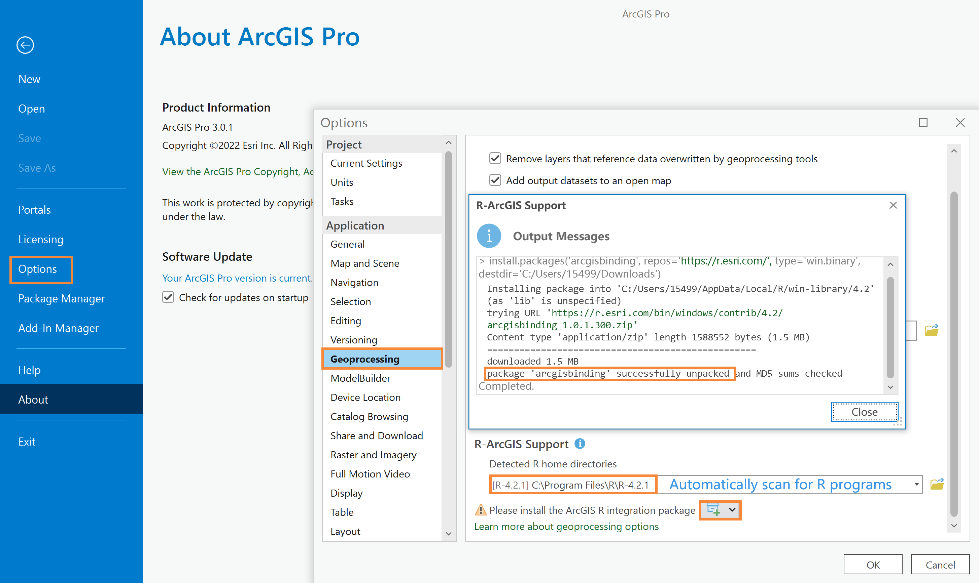

Slide 5
Functions
Use | When
arc.open(path) | Loading ArcGIS datasets, tables, and layers into an R workspace.
arc.select(object, fields, where_clause, selected, spatial_reference) | Loading a subset of the dataset into an R data frame based on specified fields and where_clause.
arc.shape(dataframe) | The shape object is required for analysis.
arc.shape2sp(dataframe) | Converting from an arc.shape_class to an sp object.
arc.sp2data(sp dataframe) | Converting from an sp data frame object to an arc.dataframe object.
arc.data2sp(dataframe) | Converting from an arc.data frame object to an sp dataframe object.
arc.shapeinfo(arc.shape(dataframe)) | Information about the geometries stored in the dataset is required. Type of geometry and spatial reference are some of the items returned.
arc.write(path, data, coords = NULL, shape_info = NULL, overwrite = FALSE) | Exporting a data frame object to an ArcGIS dataset.

Slide 6
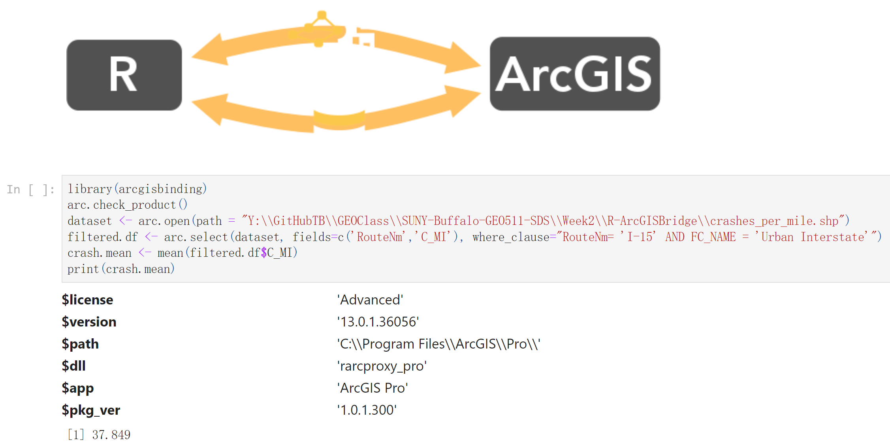
Loading a dataset into R, and finding the mean number of accidents per year per mile on I-15

